Slide 1
Multi-kilometre and
Multi-gigabit-per-second
Sub-THz Communications for Wireless Backhaul Applications
Presented By
Sai Anirudh Godavarthi Terahertz in 6G & Beyond – Spring 2026

Slide 2
Background
Problem Statement
Objectives
Methods
Experimental Setup
Results & Discussion
Limitations
Conclusion
Importance for 6G
Advantages
Agenda

Slide 3
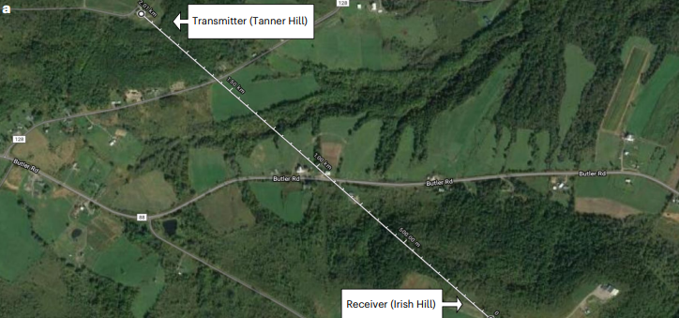
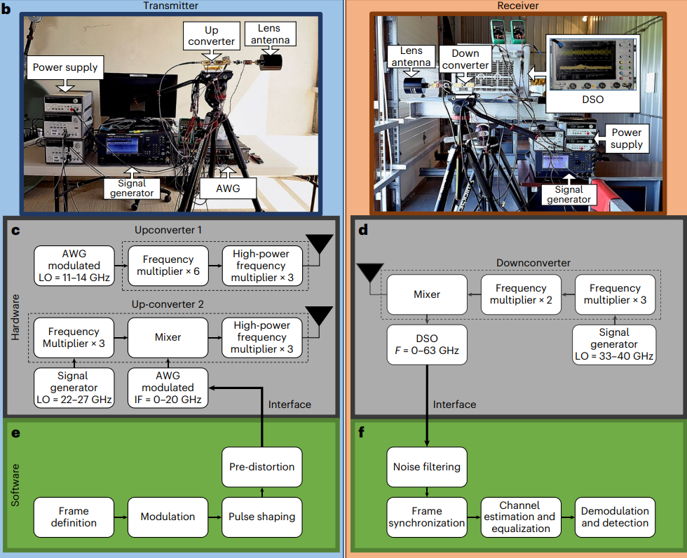
Background: High Power Trans-receivers
6G and beyond require extremely high data rates.
Sub-terahertz band (100 GHz to 1 THz) offers large bandwidth.

Slide 4
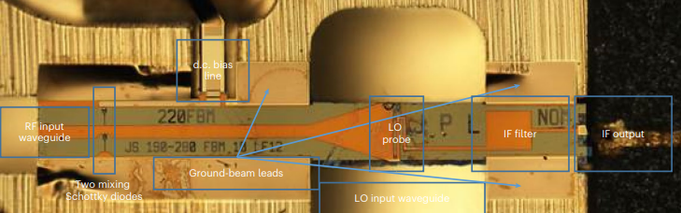
Background: Epitaxial structure of the receiver mixer.
Transmitter and receiver performance at 210–240 GHz
Long-distance wireless links at these frequencies are challenging.

Slide 5
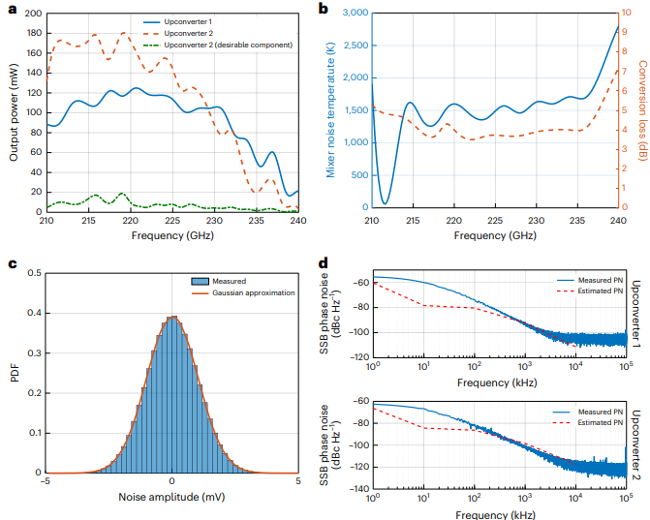
Limitations
Precise alignment required.
Atmospheric loss increases with frequency.
Hardware complexity still high.
Further optimization needed for tens of km links.

Slide 6
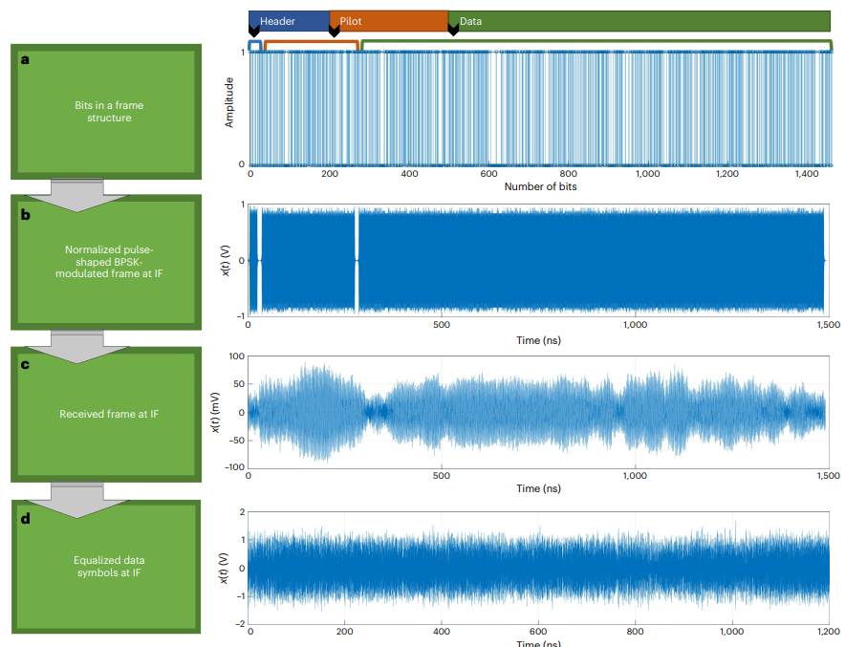
Objectives

Slide 7
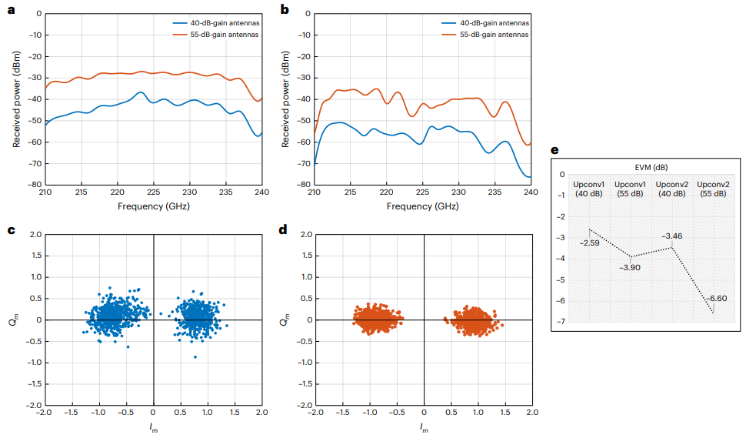
Experimental Setup
Outdoor transmitter and receiver separated by 2.03 km.
Directional High-Gain Horn-lens antennas with 40 dBi / 55 dBi gain.
Receiver uses low-noise amplifier: 35 dB gain, 1 dB noise figure.
Signals transmitted around 225 GHz.

Slide 8




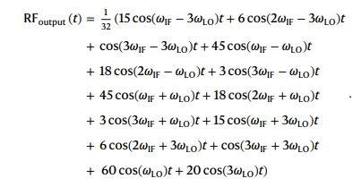


Problem Statement
Methods: Power Combining & Signal Processing

Slide 9
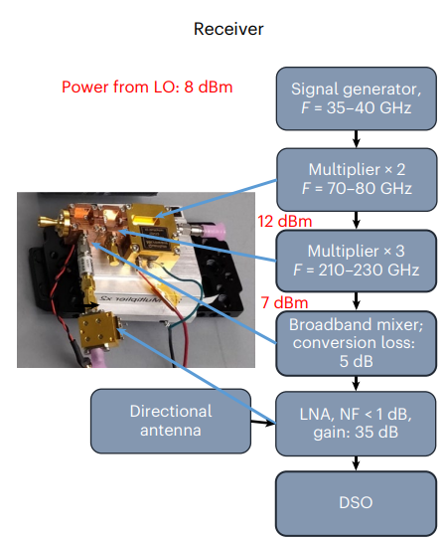
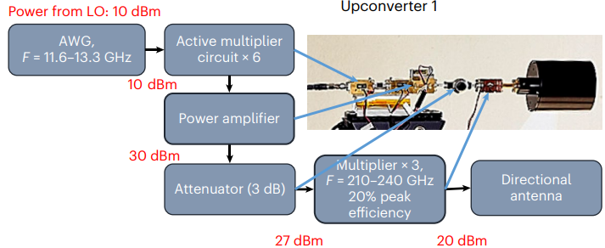
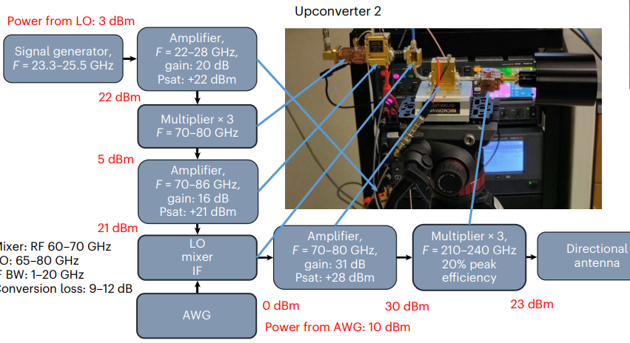
Methods: Transceiver Configurations
Full configuration of the transceiver chain with mixers, multipliers and amplifiers
with the corresponding powers at different stages.

Slide 10
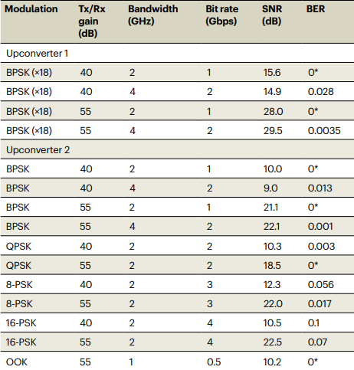
Results & Discussion
Data transmission using source-modulated (upconverter 1) and
IF-modulated (upconverter 2) system.

Slide 11
Importance for 6G
Useful for wireless backhaul in cities and rural areas.
Fast emergency deployment when fiber is unavailable.
Can connect mmWave / Wi-Fi access points to core network.

Slide 12
Advantages
High capacity without laying fiber.
Rapid deployment.
Scalable for future dense networks.
Potential lower infrastructure cost.

Slide 13
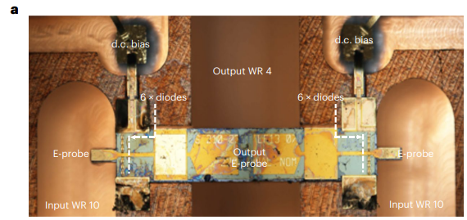
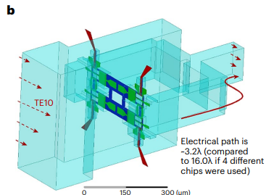
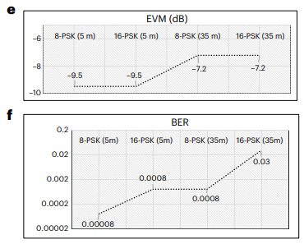
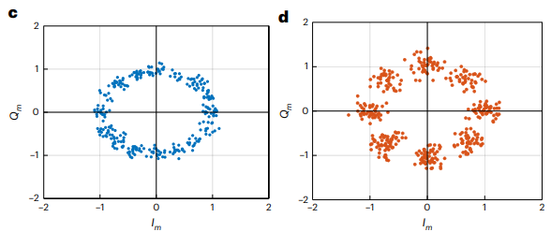
Conclusion
This paper demonstrates that long-distance, high-speed sub-THz communication is practical and can play a major role in future 6G wireless backhaul systems.

Slide 14
Thank You
Any Clarifications?

